Slide 1
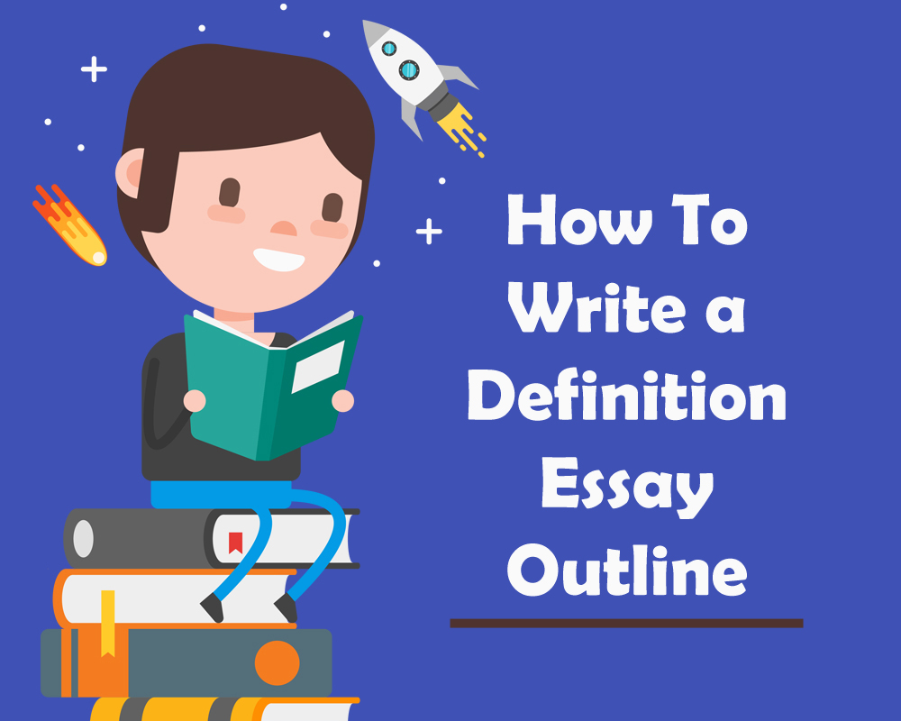

Slide 2
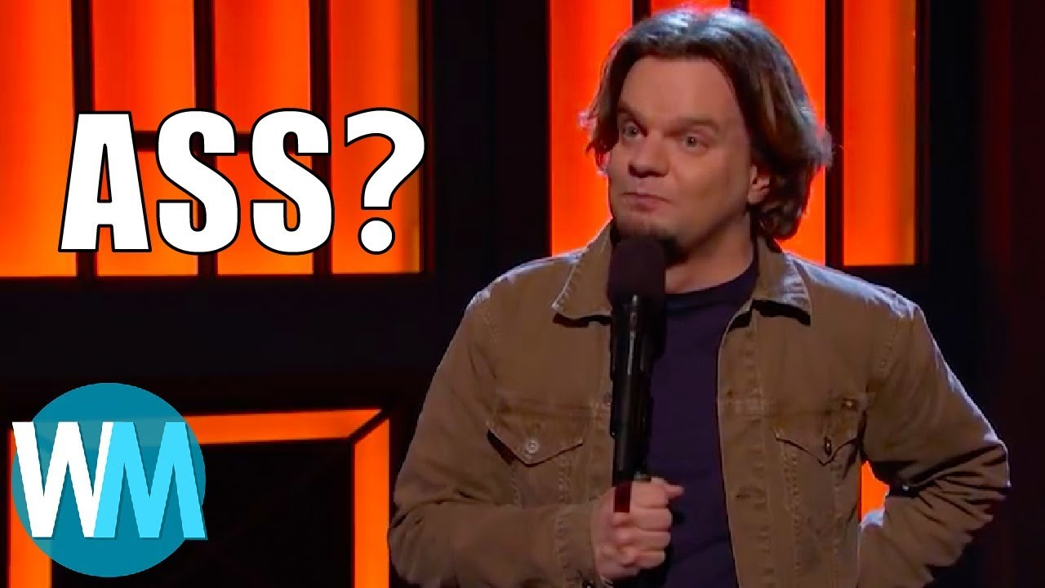
Definitions are more complex than you think..
Ismo explains why “ass” is the most complicated word in the English language https://www.youtube.com/watch?v=RAGcDi0DRtU

Slide 3
What is the definition essay?
Provides details about a concept
Interprets a word or concept in new ways
Utilizes historical context, denotation, and connotation
Focuses on complex ideas
Simple concepts won’t provide enough details
Try abstract concepts, places, or adjectives

Slide 4
Outlining Parts | The Introduction
Who is your audience?
Imagine a specific group of people
What background do they need?
Why should they be interested?
How has the concept previously been defined?
Are there any confusing components of the concept?
Does the definition change over time or across cultures?

Slide 5
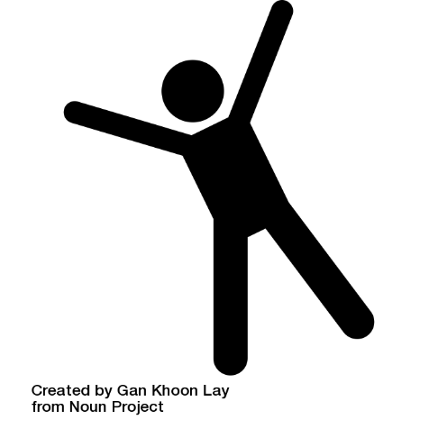
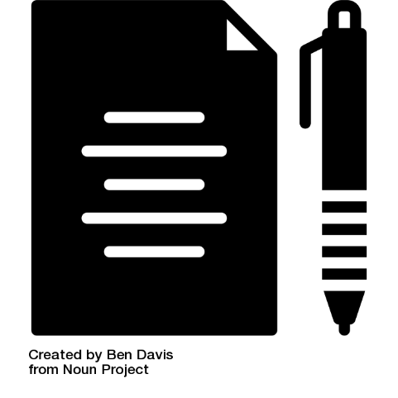
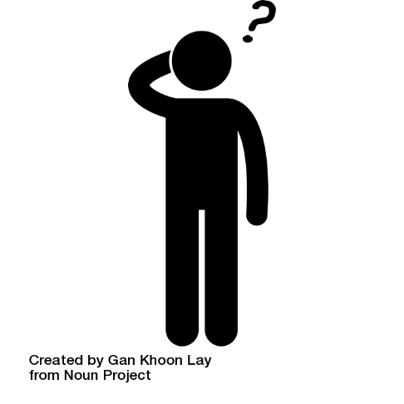
INTRODUCTION
CONCLUSION
The introduction must include a thesis statement
Go beyond the definition of a word, and suggest how complex the word can be
What does having many definitions suggest about a word?
Why does it matter?
Go beyond the obvious here, don’t just say “it means it’s diverse/unique”

Slide 6
What does it sound like?
X
✔
“The word ‘mother’ has many connotations, which just goes to show that mothers can be anything to anyone.”
“…which shows us how diverse the definition of ‘mother’ is.”
“The word ‘mother’ has many different connotations, which implies that a mother’s job is more than just the caregiver we expect it to be. With so many roles, we should respect the work that they do in and outside the home because it is diverse and requires many skills.”

Slide 7
Each body paragraph should focus on a different element of the definition
History (etymology and context)
Denotation (expectations)
Connotation (social and cultural)
Transitions should be meaningful, and explain how each point connects to the previous.
Avoid “first, next, finally, moreover”
See your transitions handout

Slide 8
Body Paragraphs | 1. History
Discuss the origins of a word/concept
Etymology for roots and origins
Prefixes and suffixed
Different forms of the word
In addition to “climber” also look up “climb.”
This paragraph is strictly factual
Work to understand WHY this background is important or interesting. It can guide your future research.

Slide 9
Origins of “Climber” (n.)
early 15c., "one who climbs," agent noun from climb (v.). Botanical meaning "a plant that rises by attaching itself to some support" is from 1630s.
Climb (n.)
1580s, "act of climbing," from climb (v.). Meaning "an ascent by climbing" is from 1915, originally in aviation.
Climb (v.)
Old English climban "raise oneself using hands and feet; rise gradually, ascend; make an ascent of" (past tense clamb, past participle clumben, clumbe), from West Germanic *klimban "go up by clinging" (source also of Dutch klimmen, Old High German klimban, German klimmen "to climb").
A strong verb in Old English, weak by 16c. Other Germanic languages long ago dropped the -b. Meaning "to mount as if by climbing" is from mid-14c. Figurative sense of "rise slowly by effort or as if by climbing" is from mid-13c. Related: Climbed; climbing.

Slide 10
Let’s break all that down!

Slide 11
Botanical meaning "a plant that rises by attaching itself to some support”
“Meaning "an ascent by climbing" is from 1915, originally in aviation.”
“c. 1600, "native of or dweller in mountains," from mountain + -eer or from French montanier. The verb meaning "to be a mountain-climber" is from 1803”
Note: I also looked into “mountaineering” for comparison
That’s interesting because we may have learned to climb from watching the world around us.
Obviously we climbed before flying in planes, but I wonder why we also call flying climbing. Is it because it sounds more possible?
Climbing’s roots as an activity seem to be from early 1800s, or late 1700s. Does that check out?
Mountaineering religiously – 1400s
Mountaineering scientific discovery – late 1700s
Rock climbing as sport – 1880s

Slide 12
Body Paragraphs | 2. Denotation
Discuss origins and development in the History paragraph, and meaning in the Denotation paragraph.
Denotation is the dictionary definition of a word.
This may overlap with etymology
For example: love can appear as several different parts of speech
Noun (emotion)
Verb (Action of loving)
Gerund (act of loving)
Adjective (love boat; love train; love letter)
What isn’t implied in the definition?
Love does not necessarily equate to affection, or sexual attraction, or even friendship
It’s helpful to discuss what we expect to see but don’t; helps create boundaries and correct misunderstandings

Slide 13
Now this is where it gets interesting: Connotations

Slide 14
“Choosing Your Grandma Name is Serious Business” by It’s a Southern Thing https://www.youtube.com/watch?v=FEnw-TDuwn0

Slide 15
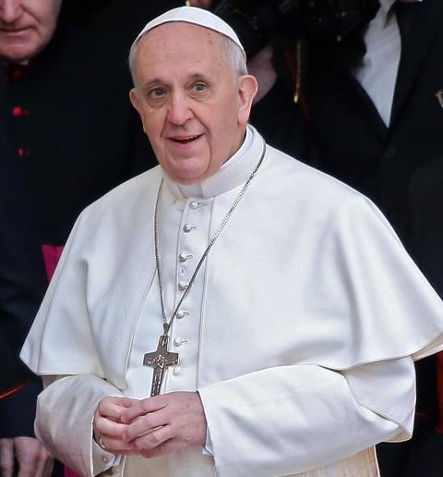
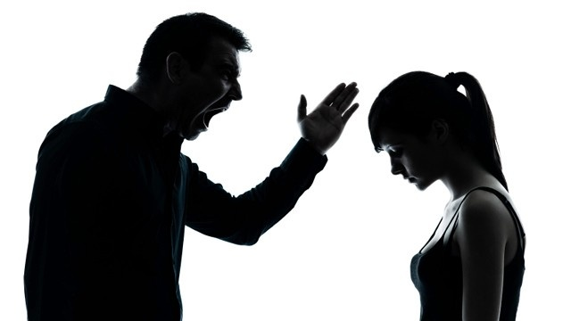
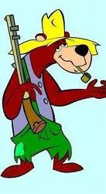
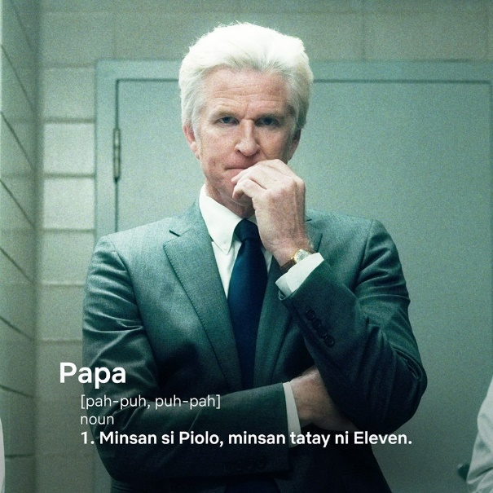
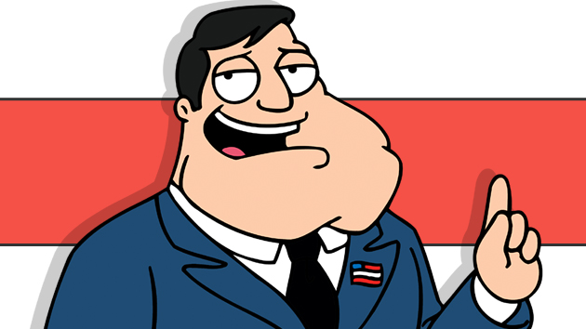
What do you call your paternal parent?

Slide 16
Body Paragraph | 3. Connotation
This should be the longest body section, because it’s where the real critical thinking happens
Connotations are the feelings or meanings that a word invokes in addition (or sometimes contrary) to its literal meaning.
Based on personal experience and others’ understanding of the word
Draw creative or artistic links.
Provide examples of the word in action.
Provide examples of synonyms for comparison

Slide 17
Your conclusion should suggest something like, “now that you’ve heard all the previous information, here’s what you can do with it.”
Suggest a course of action
Ideas for new perspectives
Make a change
End on your own words

